Slide 1
Lightning talks

Slide 2
Abraham Morales-Cruz (abmora@ucdavis)
Cantu lab, Viticulture and Enology, UC Davis
About me: 3rd year Ph.D. student, Horticulture and Agronomy
Interested in genome evolution of plant pathogens
My research: Grapevine (Vitis vinifera) fungal pathogens
Develop extraction protocols for high molecular weight DNA of filamentous fungi
Assemble the PacBio reads
Use RNAseq data as evidence for gene prediction
Compare to re-sequenced genomes (Illumina) for SVs
Other projects in my lab:
Plant-pathogen genomics lab (e.g., powdery mildew, Botrytis, pierce’s disease, red blotch virus)
Using PacBio and testing 10x, BioNano and Dovetail to get a better grapevine genome
Using parental sequence data to try and separate haplotypes of commercially important varieties (e.g. cv Cabernet Sauvignon)
More info: http://cantulab.github.io/

Slide 3
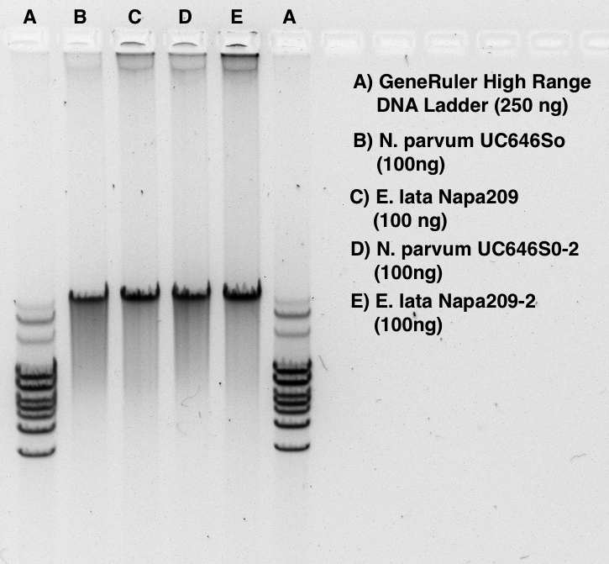
Abraham Morales-Cruz (abmora@ucdavis)
Cantu lab, Viticulture and Enology, UC Davis
Eutypa lata:
ascomycete, plant pathogen,
~50 Mb genome size, haploid
Eutypa lata EN209 assembly
48 Kb
12 Kb (cutoff) library
11 SMRT cells
N50 read length: ~18 kb
Mean coverage = 128.72X
Assembly N50: 6.5 Mb
Notes:
Telomere repeats: 5'-(GGGTTA)-3’ 5'-(TAACCC)-3'

Slide 4
Jessen V. Bredeson
University of California Berkeley
My research focuses on orphan crop species, such as cassava and yam, grown by smallholder farmers in Africa. Our lab accelerates the pace of a crop’s improvement by providing/improving the genomics resources available to breeders and biologists. As a bioinformaticist, I perform de novo assembly, annotation, and population genetic analysis of HTS data, and develop algorithms as solutions in these areas.

Slide 5
Jessen V. Bredeson
University of California Berkeley
Presently, I am de novo assembling the genomes of cassava (Manihot esculenta) and yam (Dioscorea alata) using Falcon, and gap-filling the existing Illumina-based assembly of frog (Xenopus laevis) with PBJelly. Using PacBio data, our lab has increased the contiguity of the cassava and frog assemblies by 10- and 25-fold, respectively. From this workshop I hope to learn how to optimize, and further improve, the assemblies of these species and gain insight into methods for discovering structural variation compared to related species.

Slide 6
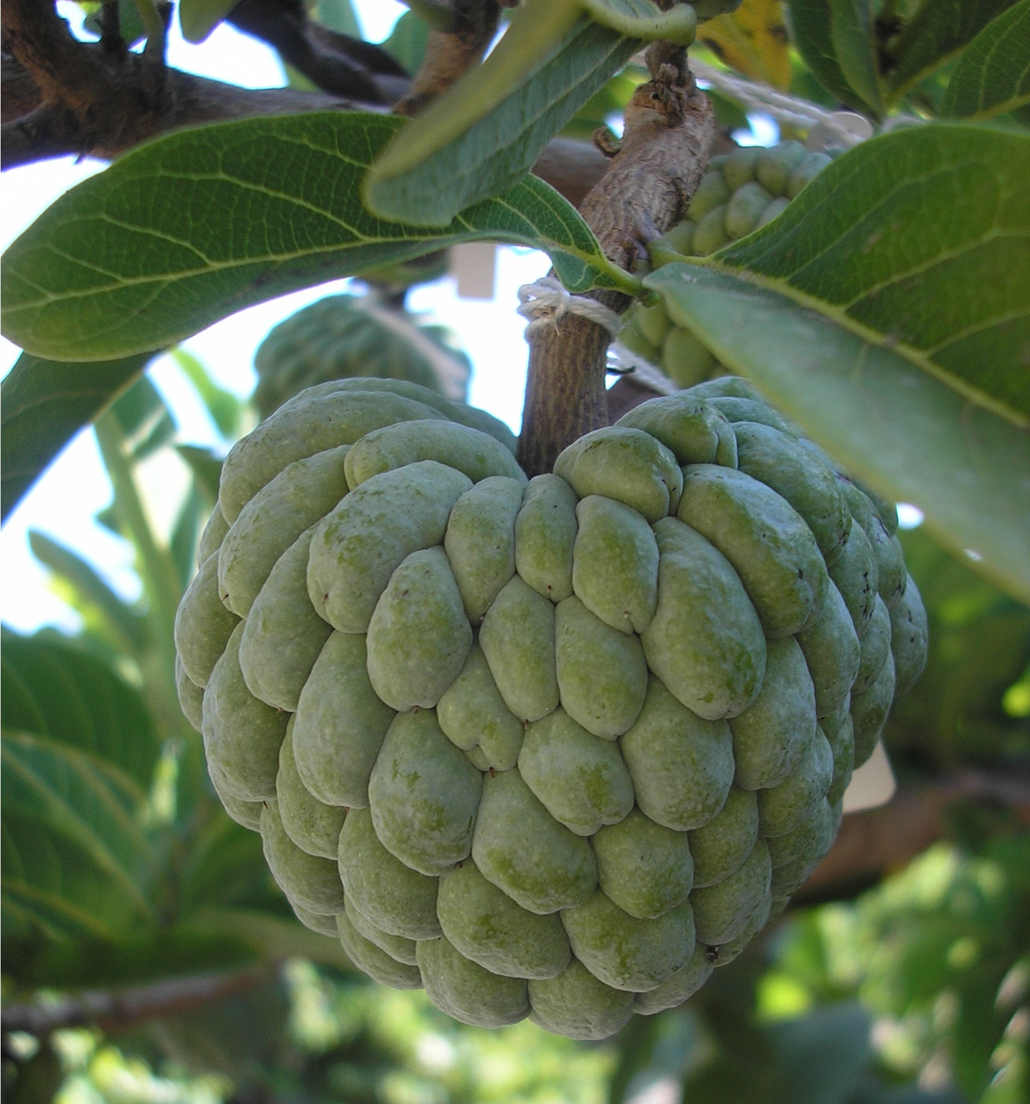
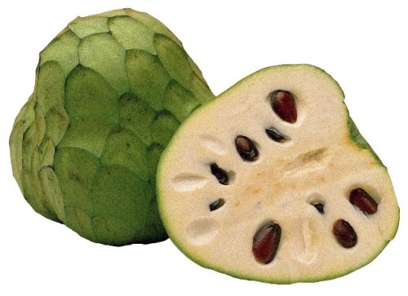
Charles Gasser
UC Davis, Mol Cell Biol
Assembly and annotation project on Annona squamosa, the sugar apple, a major tropical fruit crop. Collaborating with a group in Peru planning more extensive work on Annona cherimola, the cherimoya, a closely related fruit. 1 Gb genomes.
Work related to moving seedless trait from sugar apple to cherimoya.

Slide 7
David Luecke
UC Davis
I’m interested in genetic causes of phenotypic evolution
Non-genomic:
Gene expression change via enhancer evolution
Organ size evolution via changes in growth parameters
Genomic:
Gene family evolution in expanded set of sensory organs

Slide 8
David Luecke
UC Davis
I’m interested in genetic causes of phenotypic evolution
Non-genomic:
Gene expression change via enhancer evolution
Organ size evolution via changes in growth parameters
Genomic:
Gene family evolution in expanded set of sensory organs

Slide 9
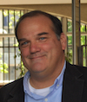


Miguel L Allende
Faculty of Sciences
University of Chile
I am a group leader and Professor at the University of Chile (www.zebrafish.cl) and member of the Center for Genme Regulation at the same institution (www.genomacrg.cl).
While we do mostly basic research in developmental biology of zebrafish, we are currently examining the genomes of extremophile fish species that are endemic to South America.

Slide 10
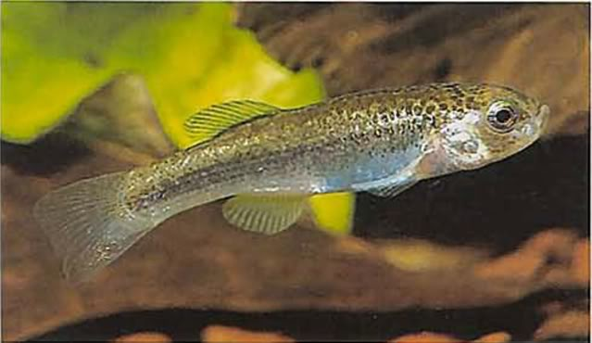
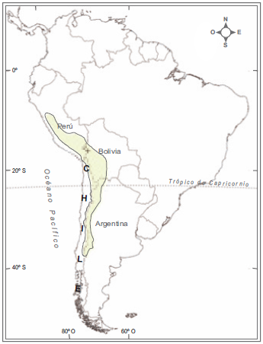
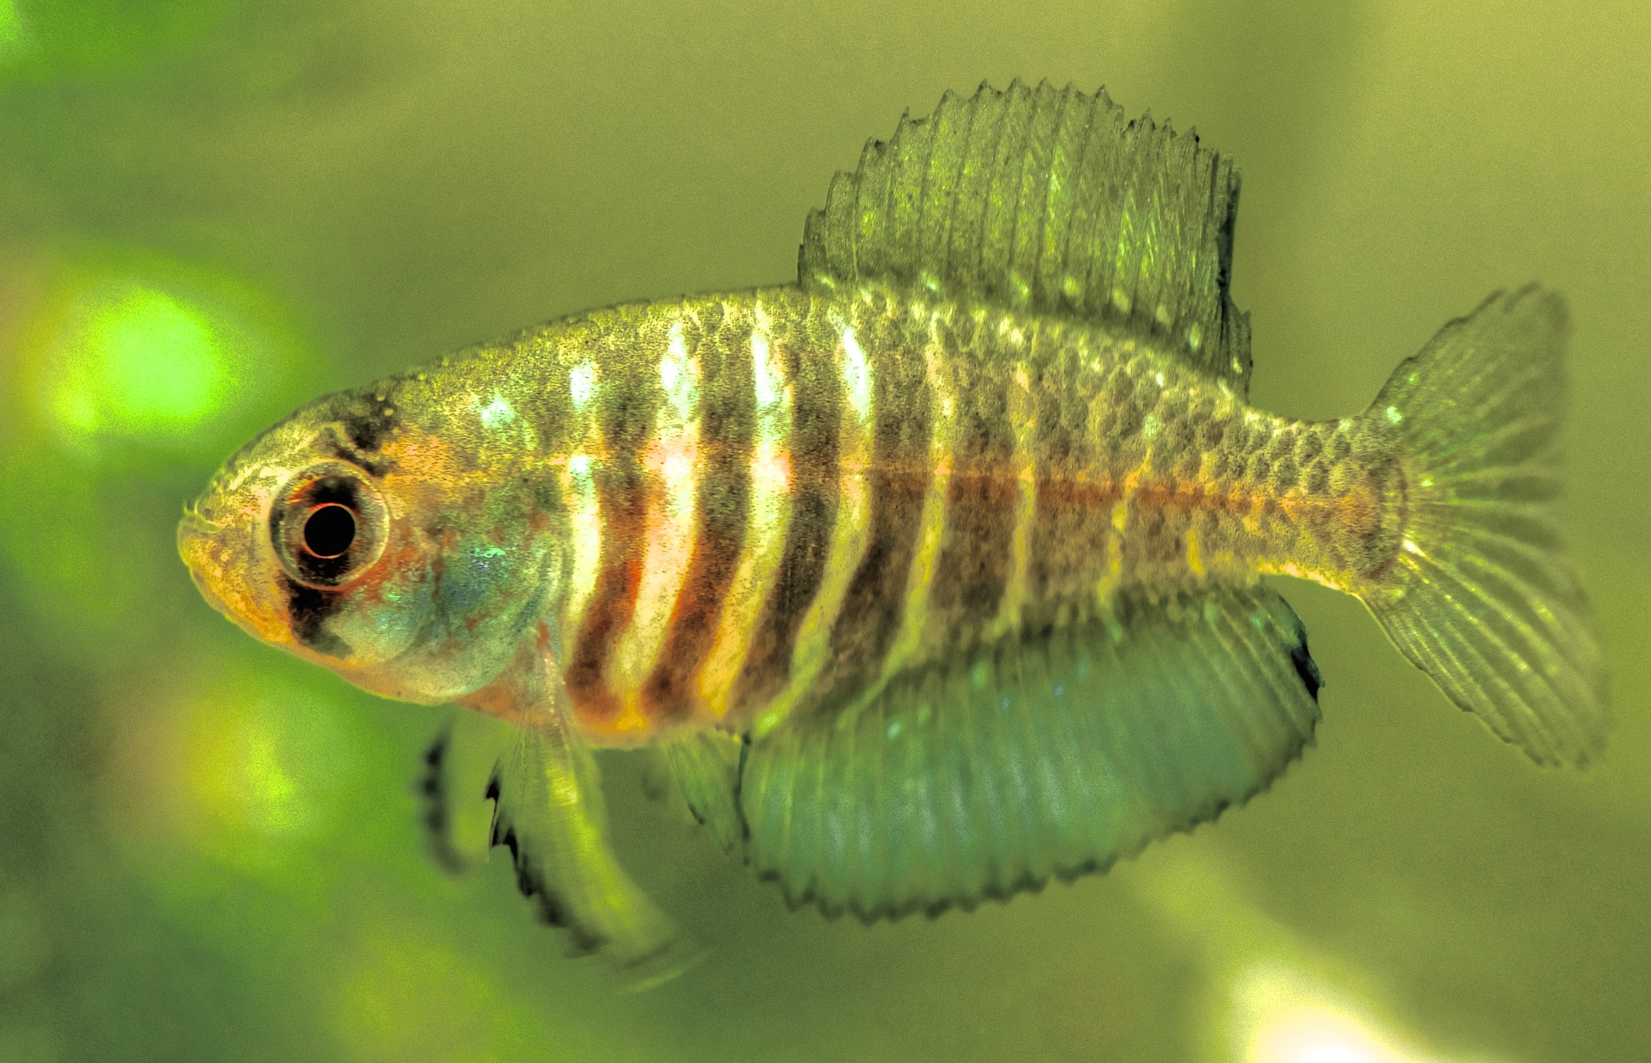
Miguel L Allende
Faculty of Sciences
University of Chile
We are sequencing the genomes of killifish (Cyprinidontiformes) that inhabit the high altitude salt lakes of Chile (Orestias genus) and annual fish of the coast of Uruguay (Austrolebias genus).
SUDAMÉRICA
Orestias ascotanensis
(800Mb)
Austrolebias charrua
(3Gb! 70% repetitive!)

Slide 11

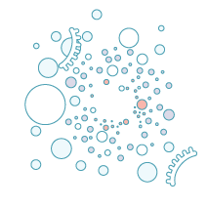
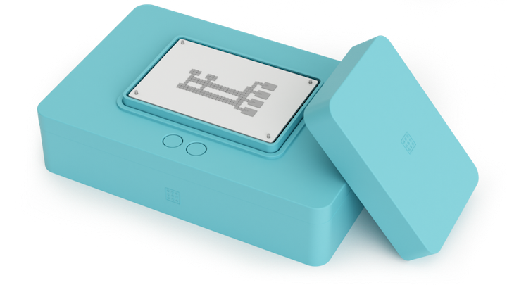

From sample to answer platform
Sample collection
Insert sample in a cartridge device
Automated workflow and data analysis
20 mins
60 mins
real time
Nestoras Karathanasis
nestor@miroculus.com
https://www.miroculus.com/
Notes:
We have developed a sample to answer diagnostics platform. Our first application is detection of stomach cancer using miRNAs in 3 simple steps. The user inserts plasma into a cartridge and from there on RNA extraction, RT-PCR and results analysis are fully automated.

Slide 12
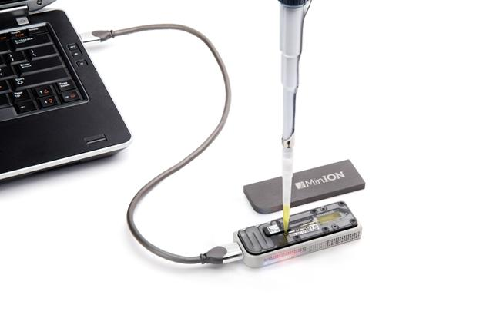
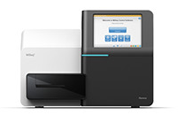
From sample to sequence
Sample collection
Insert sample in a cartridge device
20 mins
60 mins
Nestoras Karathanasis
https://www.miroculus.com/
nestor@miroculus.com
Notes:
As you saw, our cartridges are very modular (they are an open array of electrodes). We are currently evaluating how we can expand the uses of this cartridge to serve the sequencing community. Enabling scientists to go from sample all the way to a library prep that is ready to be loaded to the sequencer.
I am here to learn how to analyse long read sequencing data because we plan to generate some in a proof of concept experiment. Also, I would like your feedback on what would be an exciting/convincing experiment or application where we could automate sample prep all the way to library prep on chip. Specifically, What sample, what library and for which sequencer would be more useful to your research.

Slide 13
Amy Groh
UC Davis- St. Clair Lab
Water stress tolerance in tomato
QTL mapping
Prebreeding with S. pennellii and S. habrochaites
Combining water stress tolerance abilities

Slide 14
Amy Groh
UC Davis- St. Clair Lab
Assembling a genome for S. habrochaites
PacBio and BioNano Irys optical mapping
Focus on chr 9
QTLs for rapid onset water stress tolerance
Compare to cultivated tomato
Ultimate Goal: to find candidate genes for rapid onset water stress tolerance

Slide 15
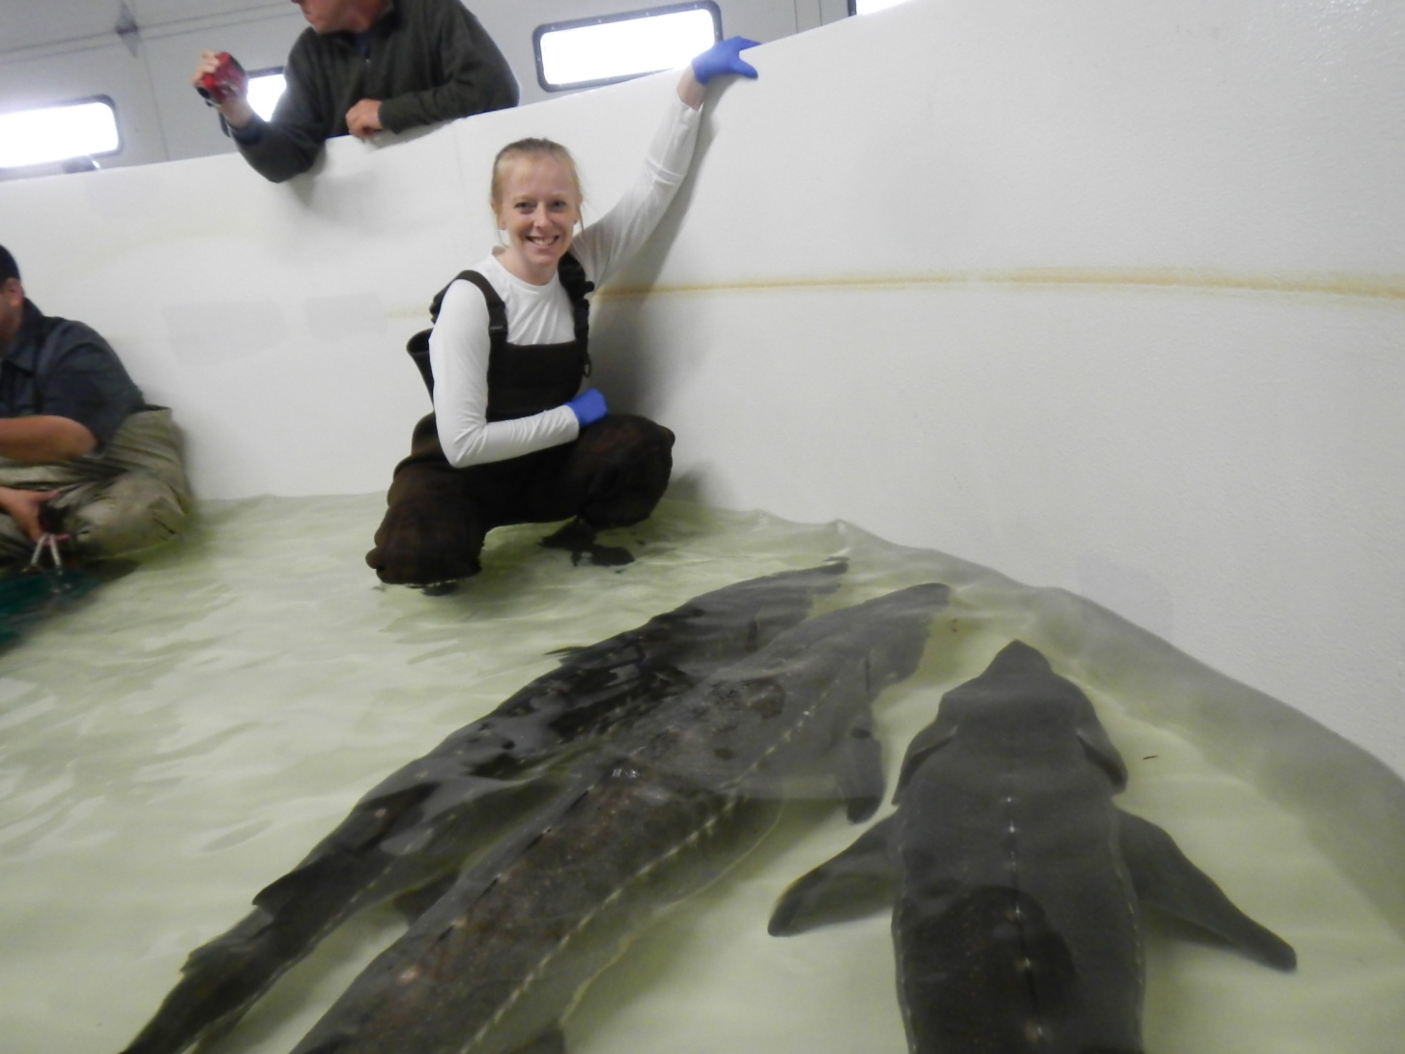
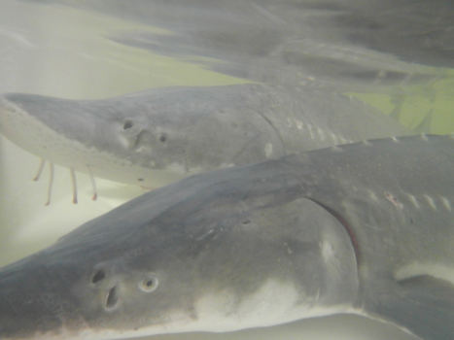
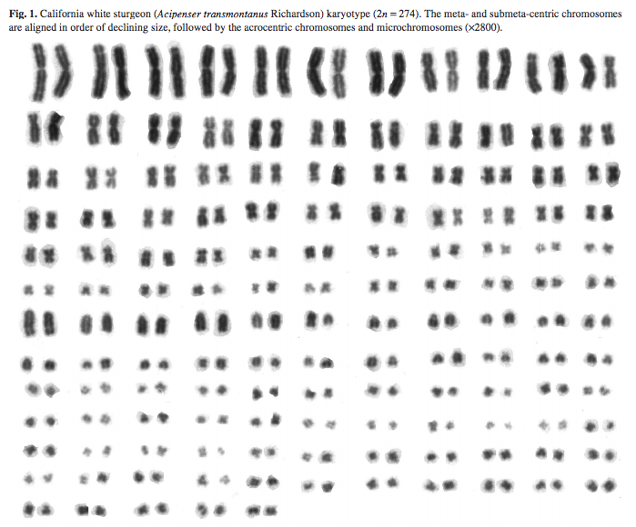
Daphne Gille
UC Davis
I would like to use high-throughput sequencing to identify a sex chromosome in a complex polyploid fish (white sturgeon) and to assemble a cervid (deer family) genome (10X and Illumina or PacBio) for conservation and management.
Van Eenennaam et al. 1998

Slide 16
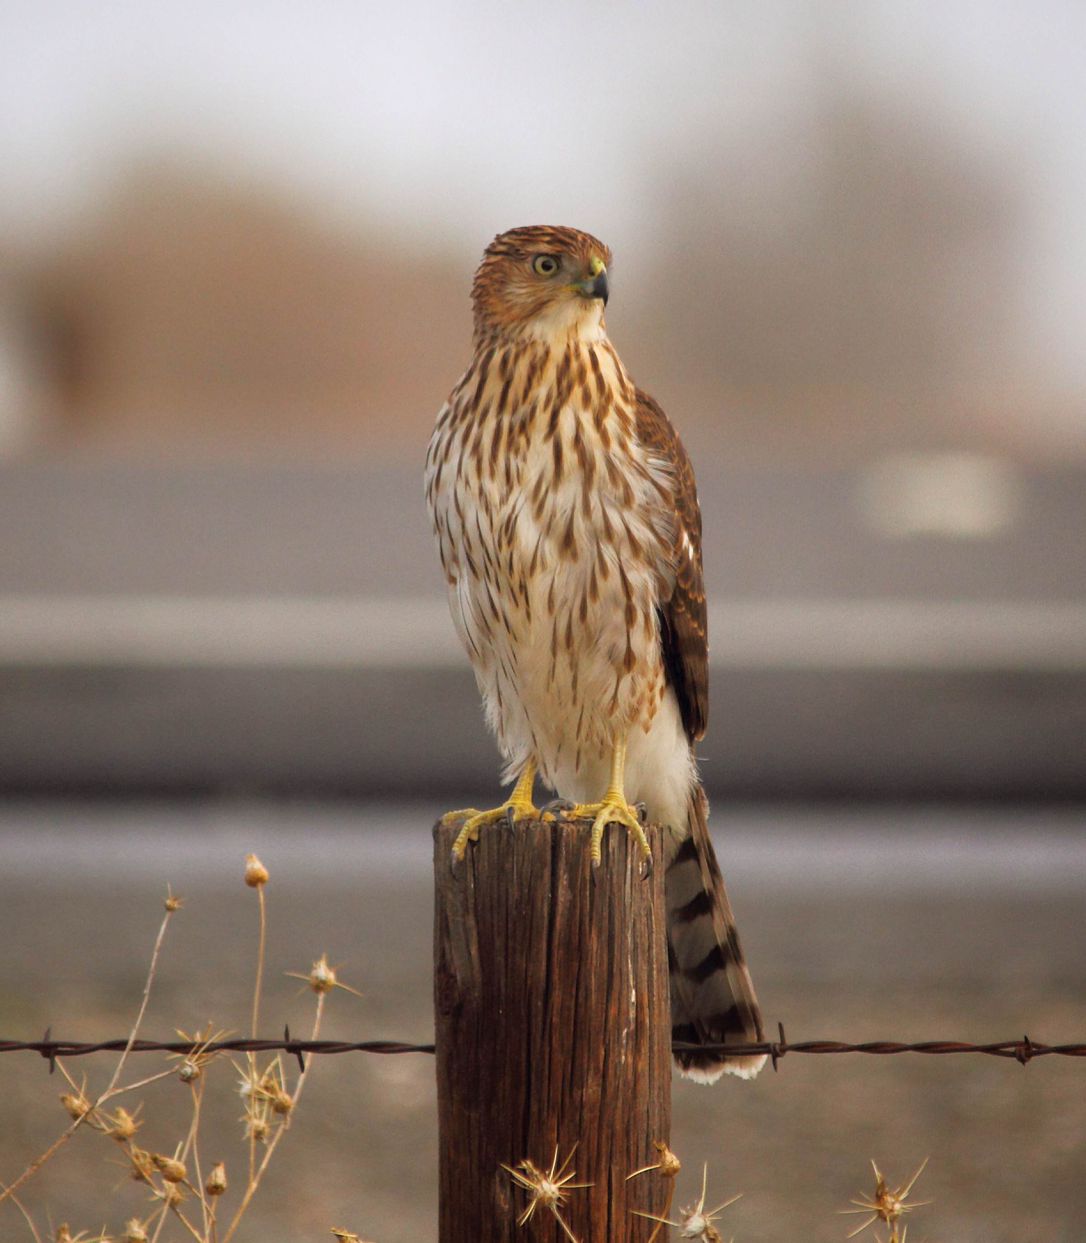
Breanna Martinico
UC Davis - Avian Sciences Graduate Group Department of Animal Science
Partnered with Golden Gate Raptor Observatory
Cooper’s Hawk
Population genetics
Migratory patterns, connectivity, and timing
Population of origin
Selection in urban vs rural nesting populations
Illumina sequencing
RADseq

Slide 17
Tom Poorten, Mitchell Feldmann
UC Davis
TJP: Bioinformatics Postdoc
Cultivated Strawberry Genomics (2n = 8x = 56)
Octoploid Genome Assembly (PB, Dovetail, 10x, Bionano)
Germplasm and Wild Species Diversity
MJF: Ph.D. Student
Karyotypic Evolution of Octoploid progenitors
Hybrid Breeding and Genomic Selection/Prediction

Slide 19
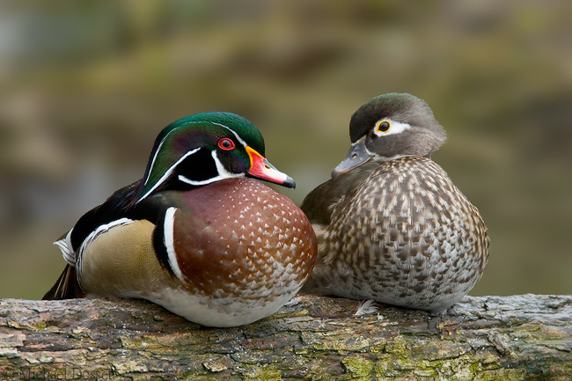
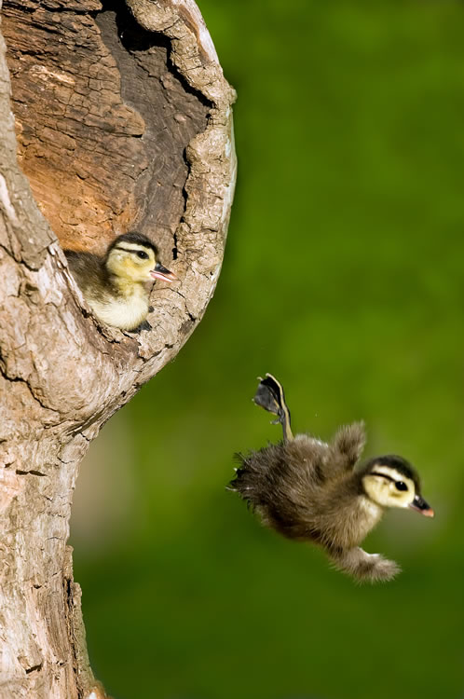
Melissa Jones
UC Davis
Avian Science with Dr. John Eadie.
Interests: Conservation Genetics, Comparative Genomics, Animal Behavior.
My lab studies conspecific brood parasitism(CBP) mainly in wood ducks (Aix sponsa). Hens are philopatric and cavity nesting, making it easy to track them over time. Parentage assessment is necessary for investigating various parameters surrounding CBP.
https://www.pinterest.com/kkm34now/wood-duck-ducklings/
http://www.animalspot.net/wood-duck.html

Slide 20
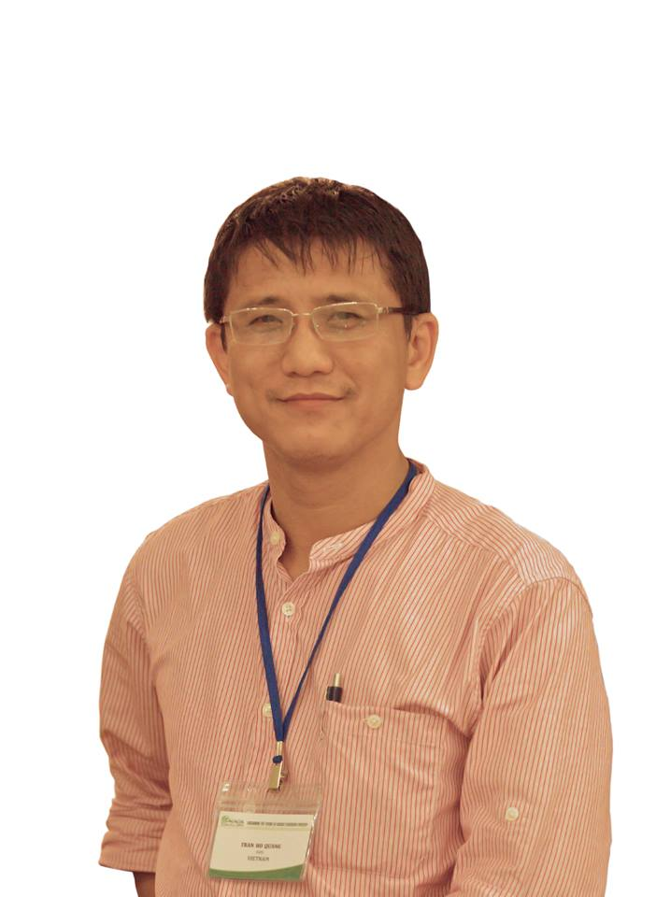
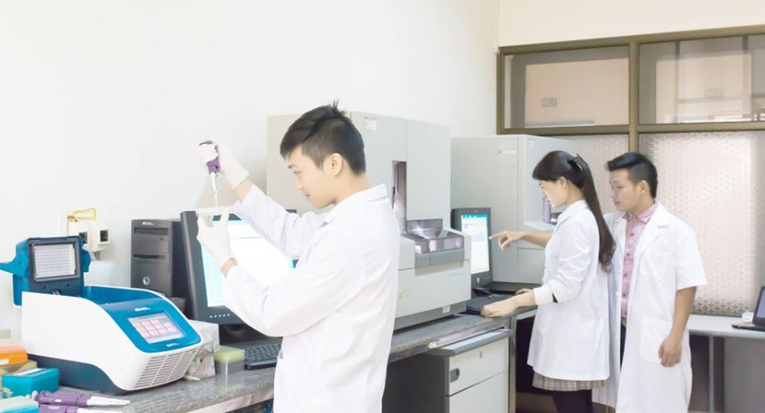
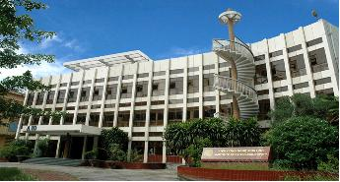
Quang Ho Tran, PhD
Visiting scholar (6 months) at Forest Genetics group
Dept. of Pant Sciences
UC, Davis
tranhoquang@ibt.ac.vn
Home Institution:
Institute of Biotechnology
Vietnam Academy of Science & Technology
18 Hoang Quoc Viet – Cau Giay – Hanoi
Vietnam

Slide 21
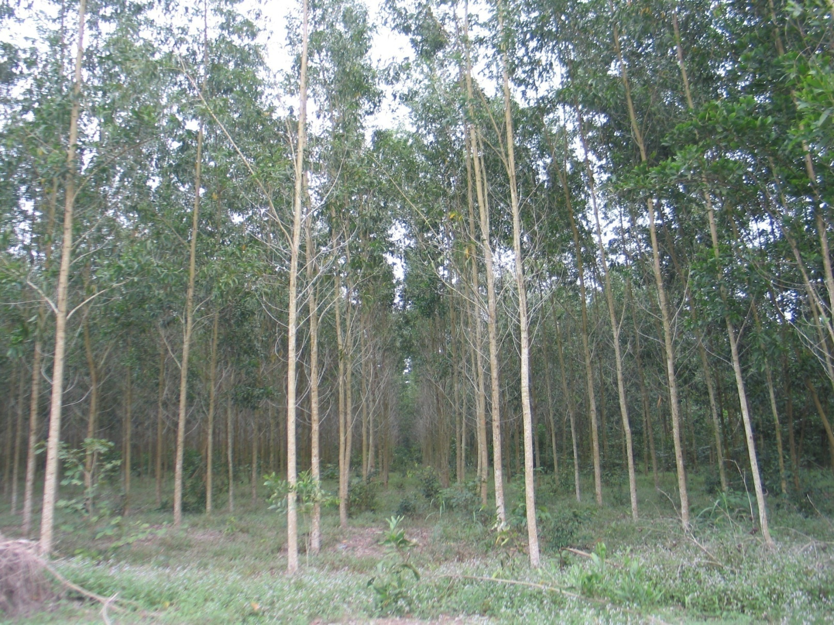
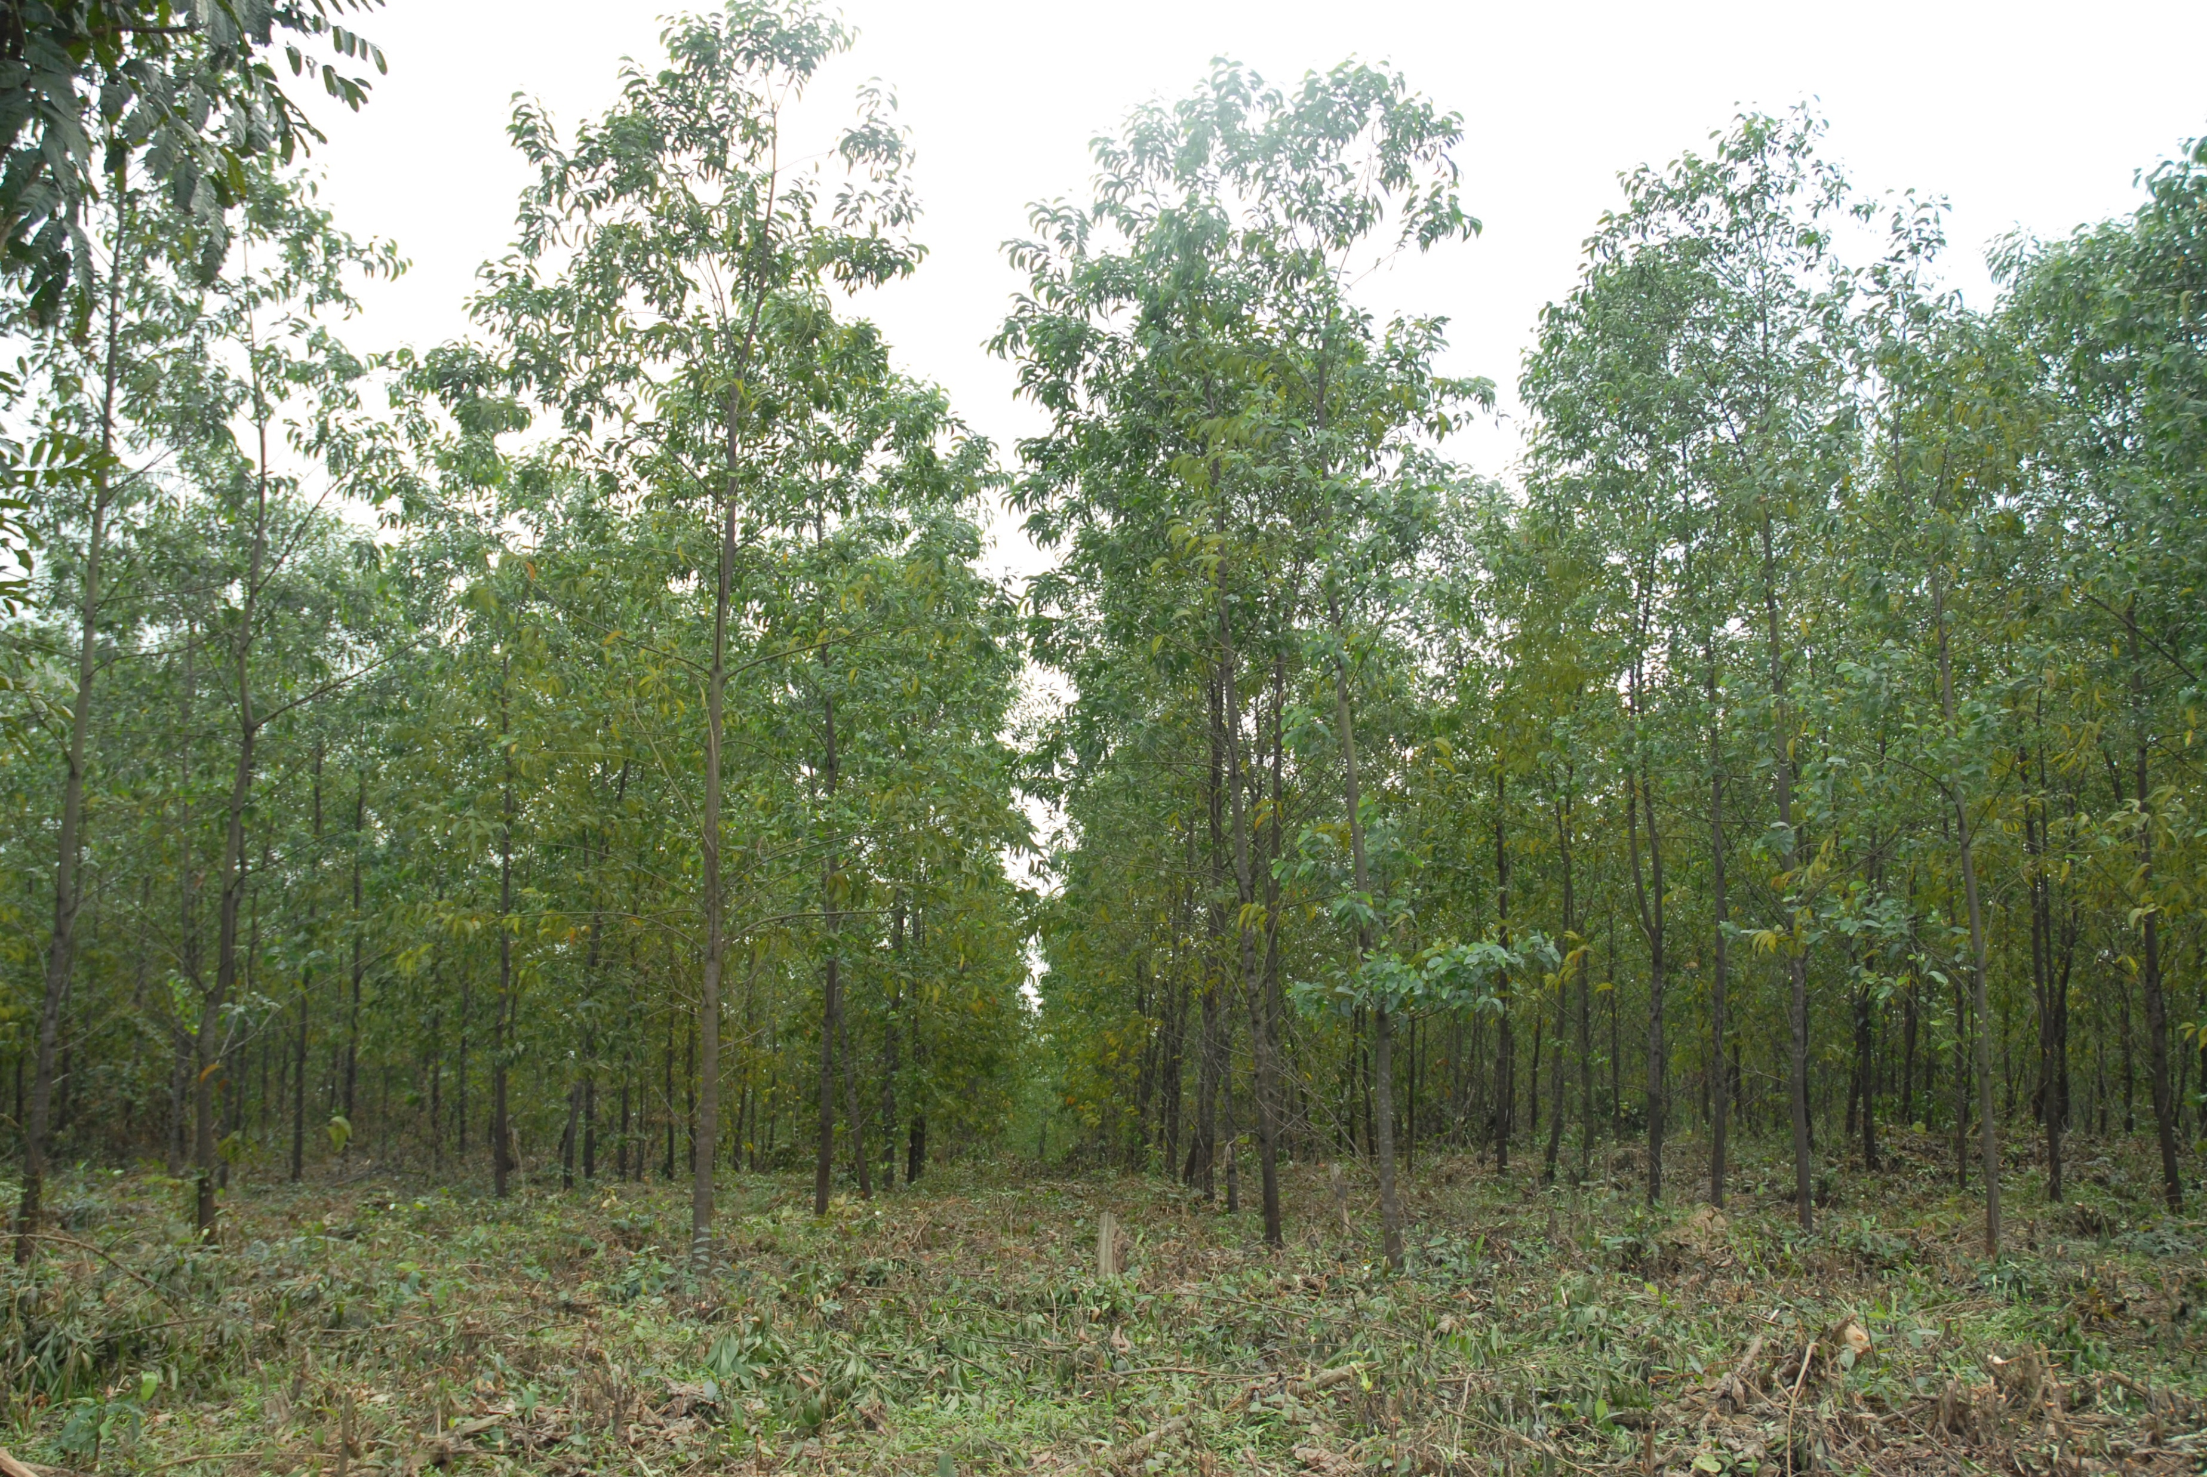
Research Interests
Forest genetics populations & gene conservation.
Gene function, molecular cloning of interest genes in plant
DNA barcoding & DNA fingerprinting to identify and classify plants
Forest trees transgenic
Research Experiences
Principle Investigator of 2 Projects at State-level on application of molecular genetics and transgenic to forest tree improvement.
Mail collaborator of Projects on forest tree improvement and plant biotechnology.
Studied Species
Forest species: Eucalyptus, Acacia, Pine
Native forest species
Non-timber forest species

Slide 22
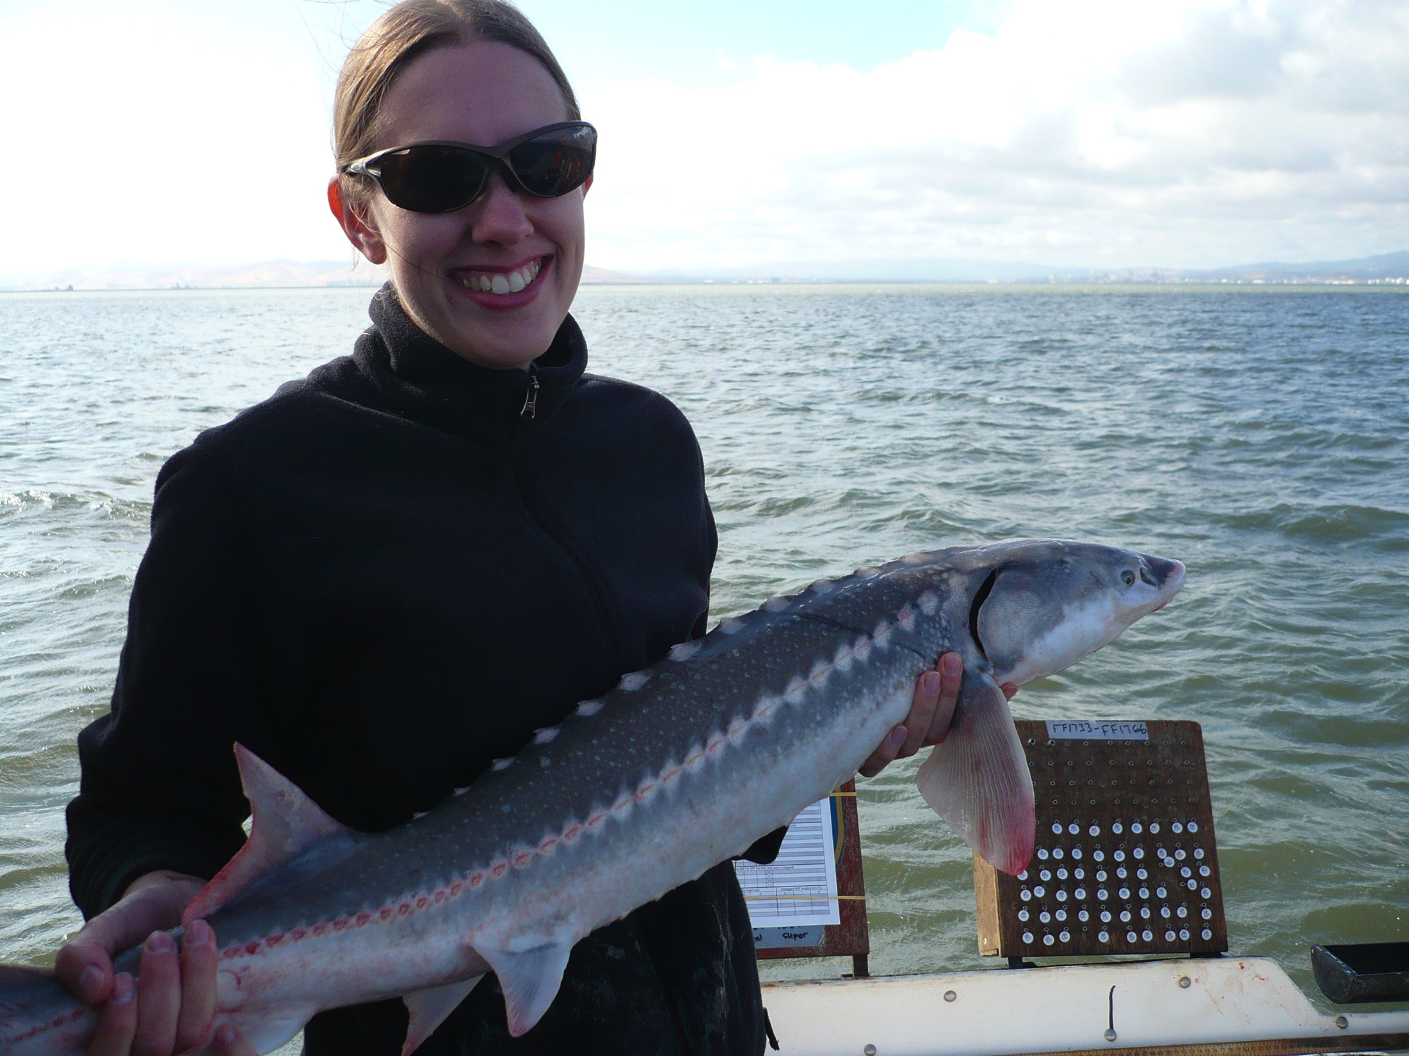
Andrea Schreier
UC Davis
Director, Genomic Variation Lab
Evolutionary and ecological questions about species of conservation conservation
Lab is moving from microsatellites to SNPs and genome assemblies.
Sturgeon: ancestral fishes with large, polyploid genomes. Model to study the role of polyploidy in vertebrate evolution.

Slide 23
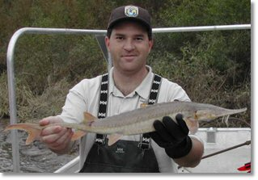
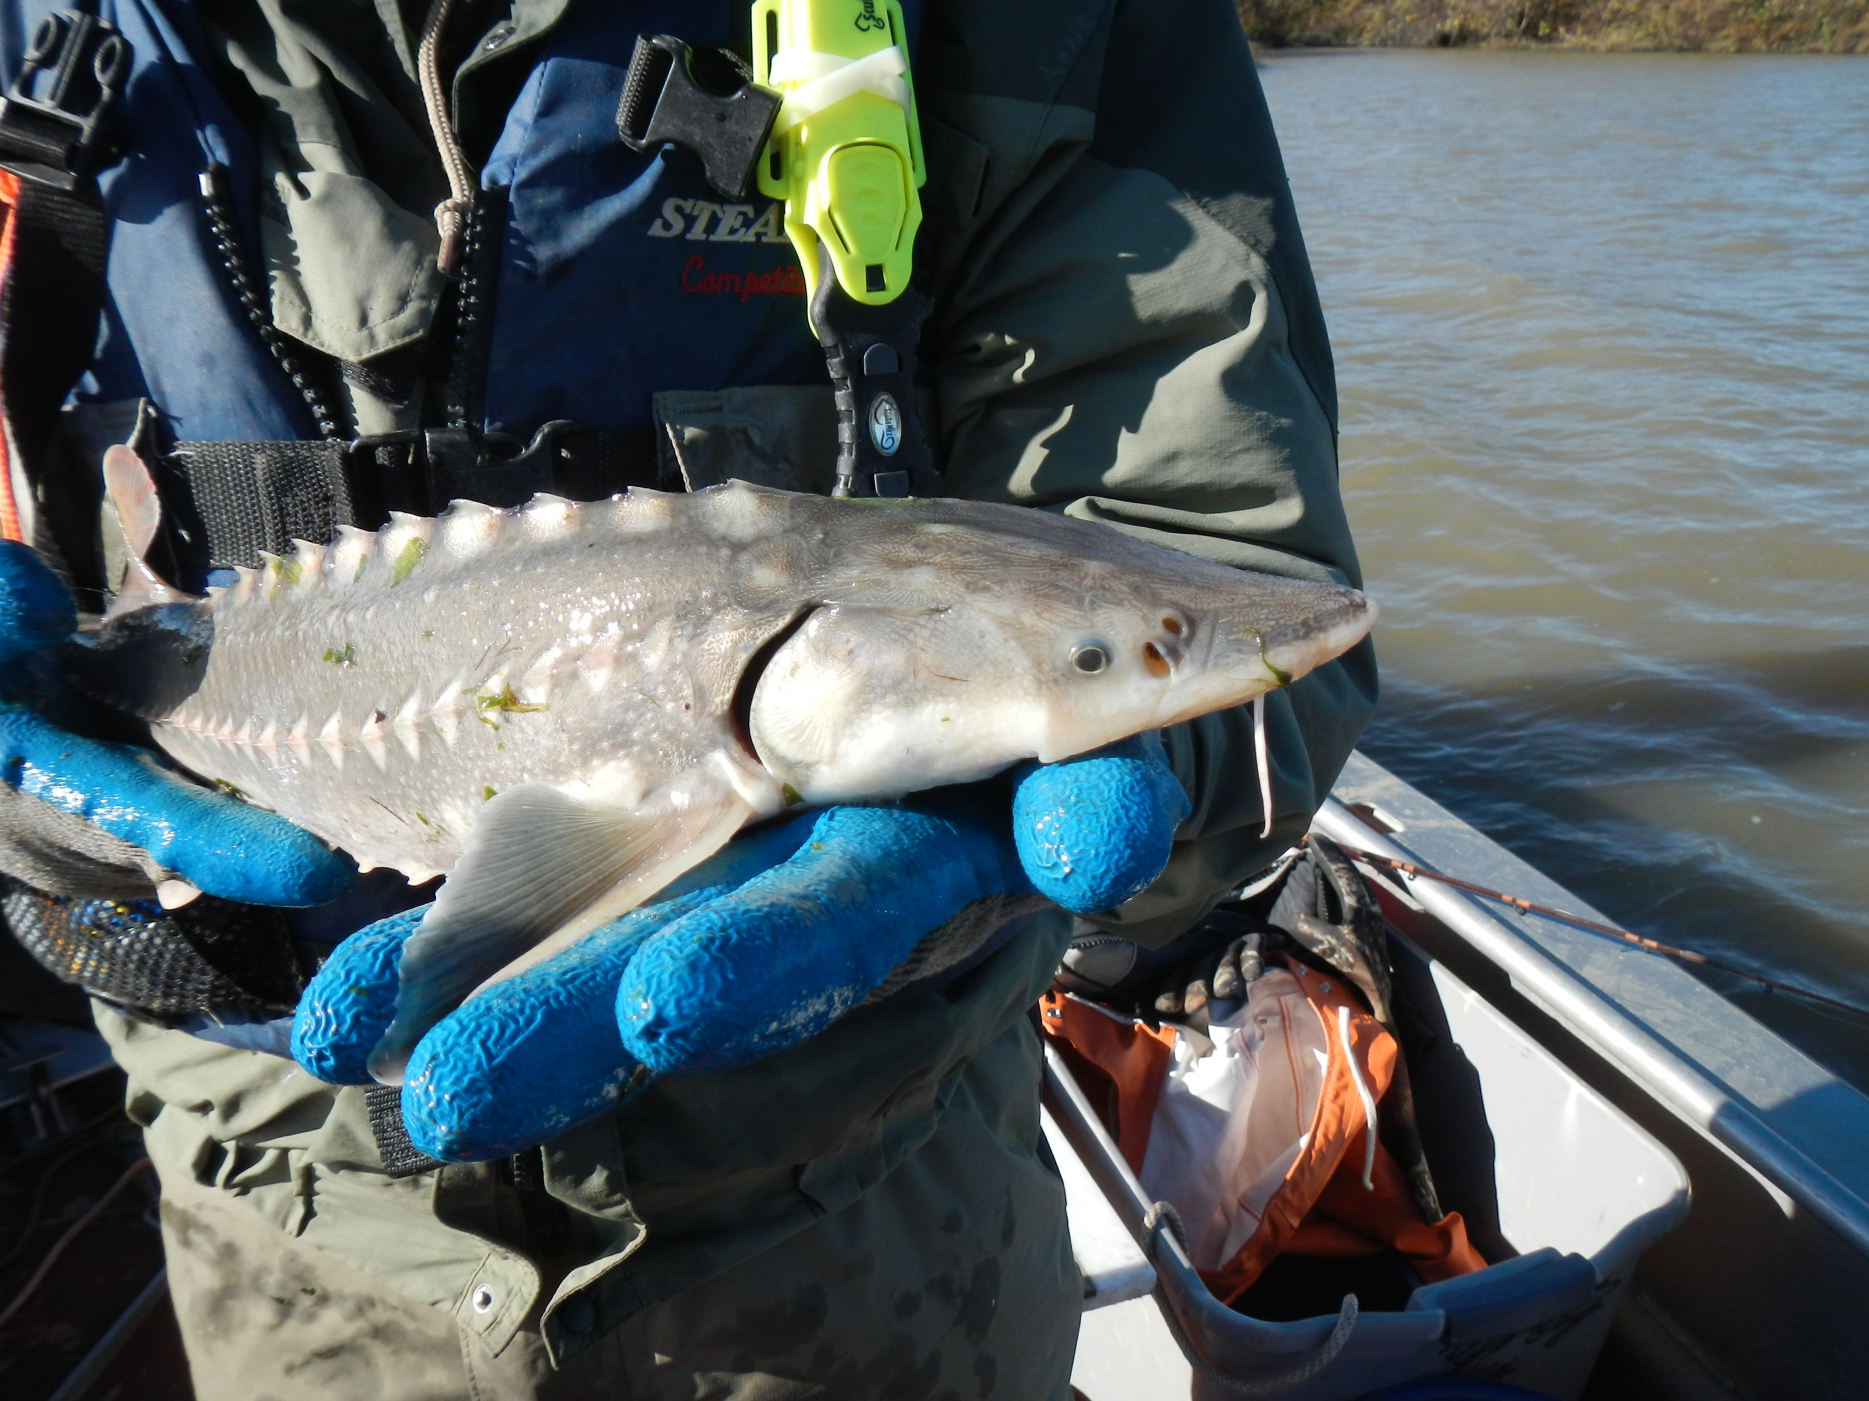
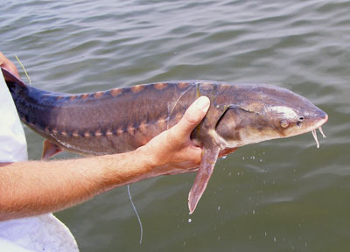
Andrea Schreier
UC Davis
A: 120 chromosomes
(tetraploid; 4N)
B: ~240 chromosomes
(octoploid; 8N)
C: 360 chromosomes
(dodecaploid; 12N)
Want to use 10X Genomics to:
Identify phased (phase-able?) SNPs that will allow us to score gene dosage for population genetic applications
Examine functional ploidy within ploidy groups
How has diploidization proceeded?
What is fate of duplicated genes?

Slide 24
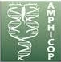



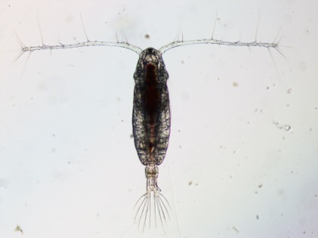
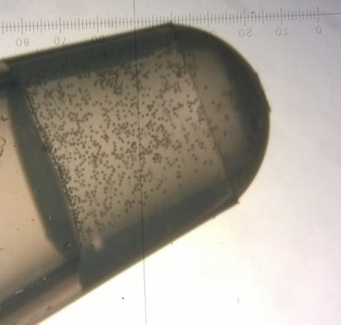
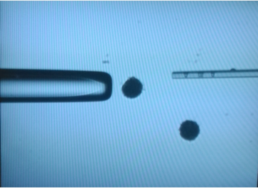
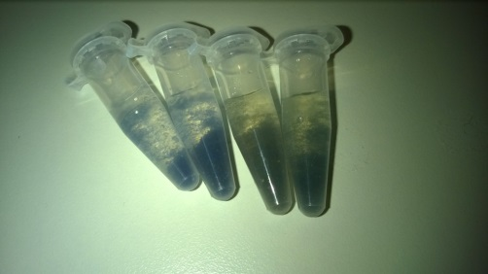
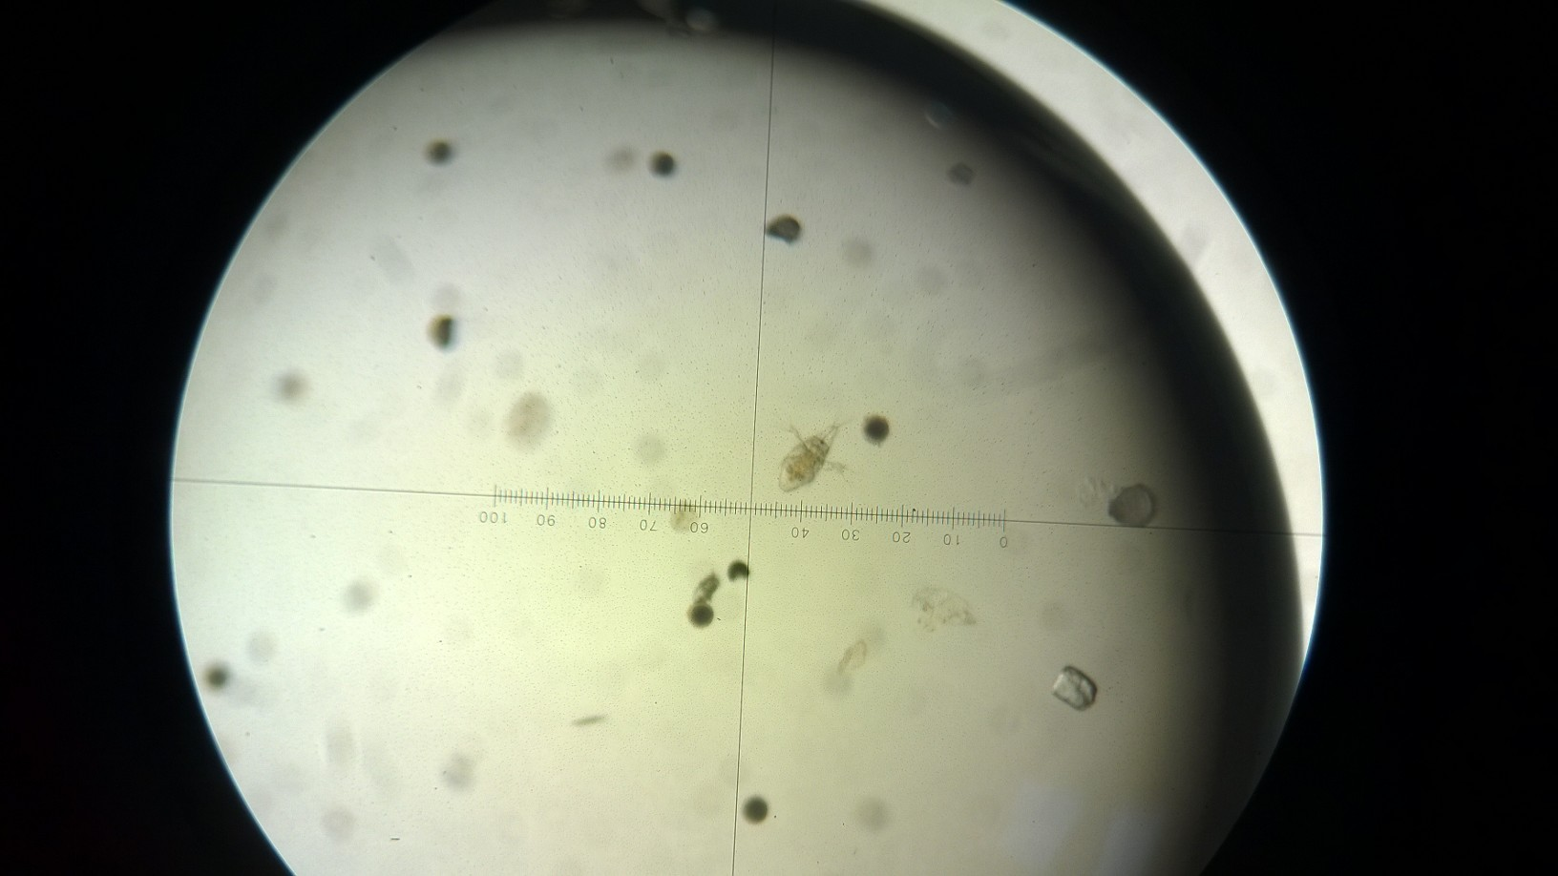
Acartia tonsa genome sequencing
1.5mm calanoid copepod (zooplankton)
30%GC, 2Gb genome (preQC), 50% repeats
Culture going for >30 years
SPAdes assembly >> discovarDN, Allpaths, etc
Current assembly N50 ca 3kb
RAM heavy (>1TB)

Slide 25
Yu Geng
Department of Plant and Microbial Biology
UC Berkeley
I am studying the molecular basis of the interactions between plant hosts and powdery mildew fungi. Our lab used to only focus on the biology of the host side. But now we decided to put more effort on the fungal side. Recently we received a grant for studying fungal effectors from oidium neolycopersici. The biggest obstacle is that the genome sequence is not available . However, luckily, as a part of the community sequencing project, the Joint Genome Institute (JGI) will sequence serval powdery mildew species for us with Pacbio. We are only responsible for providing the high molecular DNA and RNA samples.

Slide 26
Yu Geng
Department of Plant and Microbial Biology
UC Berkeley
Although JGI will do the sequencing and assembly for us, it will take about 6 months or even longer for them to release the annotated draft genome. The sequencing takes about 3 months. So potentially we will save some time by taking the assembly and annotation into our own hands. Naïve thinking….

Slide 27
Kirk Ehmsen
UCSF
I’m interested in genetic variation (its nature/distribution/consequences); I study response elements (enhancers) and gene regulation influenced by glucocorticoid receptor signaling.
--would like to learn to be able to evaluate where variation occurs (and ‘what it looks like’) between individuals and across populations, eventually to better understand how variation in regulatory modules affects gene expression affecting phenotypic traits (including disease states).

Slide 28
Andrew Whitehead
UC Davis
Pacific herring:
Sequence/assemble reference genome (PacBio or 10X?).
Population genomics – exploring reasons/consequences of massive 1993 population collapse in Prince William Sound
Killifish:
Comparative experiments toward discovering genes/pathways involved in osmoregulatory physiology and circatidal rhythmicity
Comparative transcriptomics (RNA-seq), comparative genomics (4-6 species, 10X?)

Slide 29
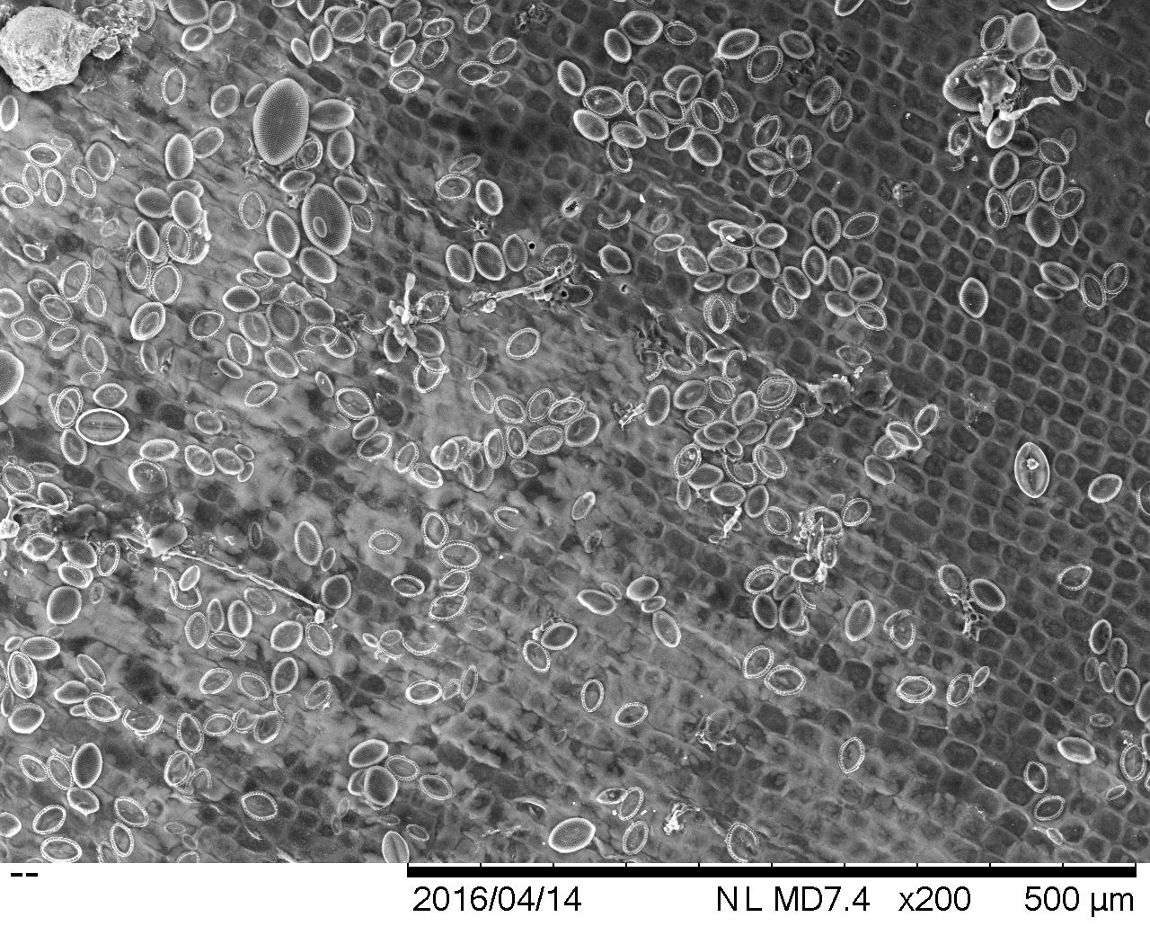
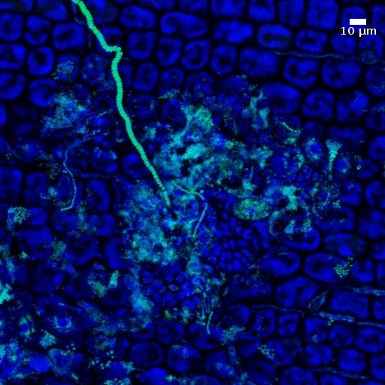
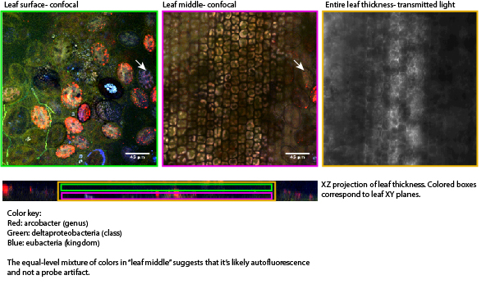
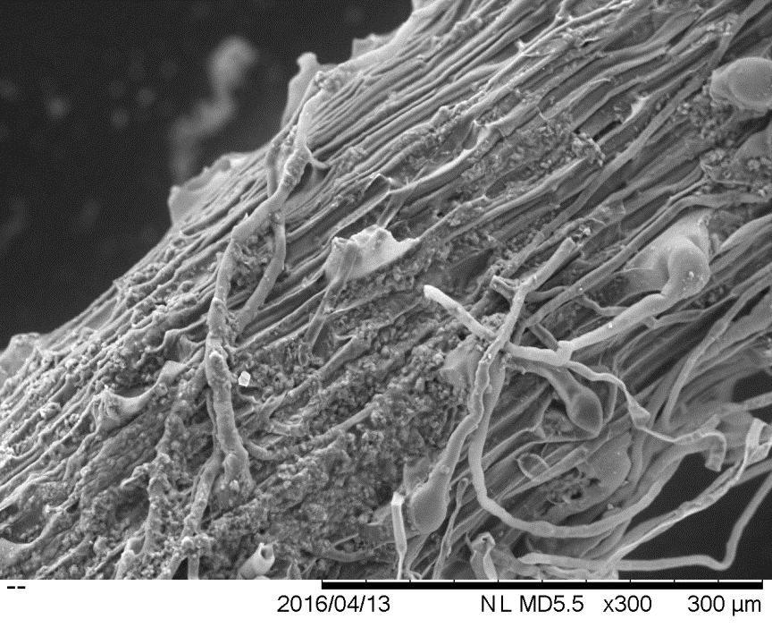
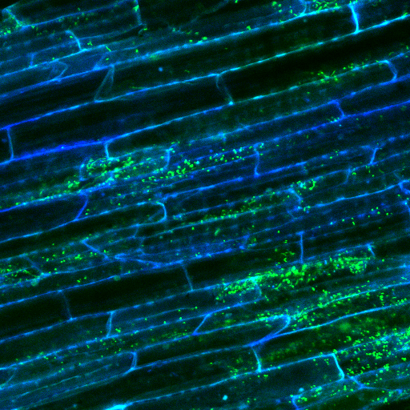
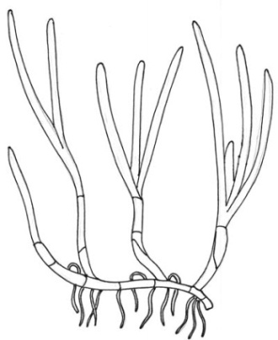
Seagrass microbiome
Femsre.oxfordjournals.com

Slide 30
Hans Vasquez-Gross
UCDavis – Genetics Graduate Group
Dubcovsky Lab
Project: Comparative genomics of stripe rusts which infects wheat. Currently, there is a 65Mbp assembly with Illumina which can be used as a reference. However, the N50 is 5,137bp with a max contig length of 49,498bp.
My first goal is to obtain an improved reference and hopefully phase the haplotypes.

Slide 31
Hans Vasquez-Gross
UCDavis – Genetics Graduate Group
Dubcovsky Lab
We stopped sequencing after 7 SMRTcells about a month ago. Did we sequence enough?

Slide 32
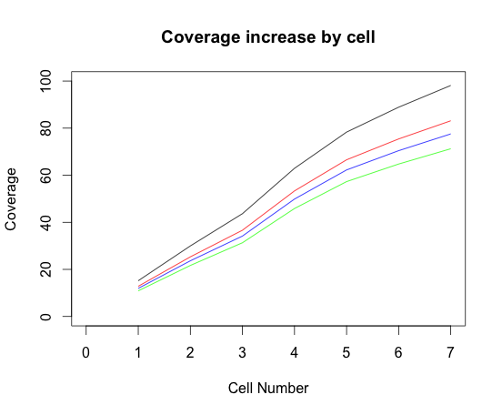
Hans Vasquez-Gross
UCDavis – Genetics Graduate Group
Dubcovsky Lab
We stopped sequencing after 7 SMRTcells about a month ago. Did we sequence enough?

Slide 33
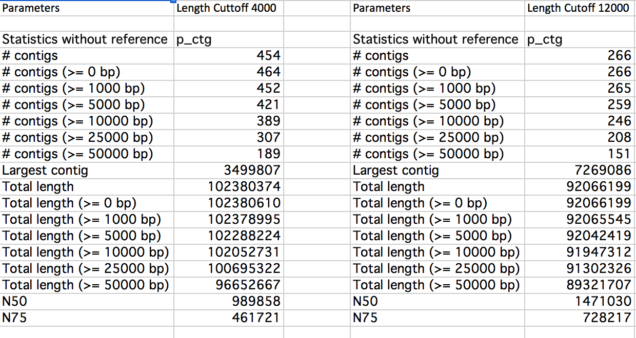
Hans Vasquez-Gross
UCDavis – Genetics Graduate Group
Dubcovsky Lab

Slide 34
Hans Vasquez-Gross
UCDavis – Genetics Graduate Group
Dubcovsky Lab
Future Work:
Assembly QC
Run Falcon_unzip to phase contigs and make haplotigs

